Slide 1
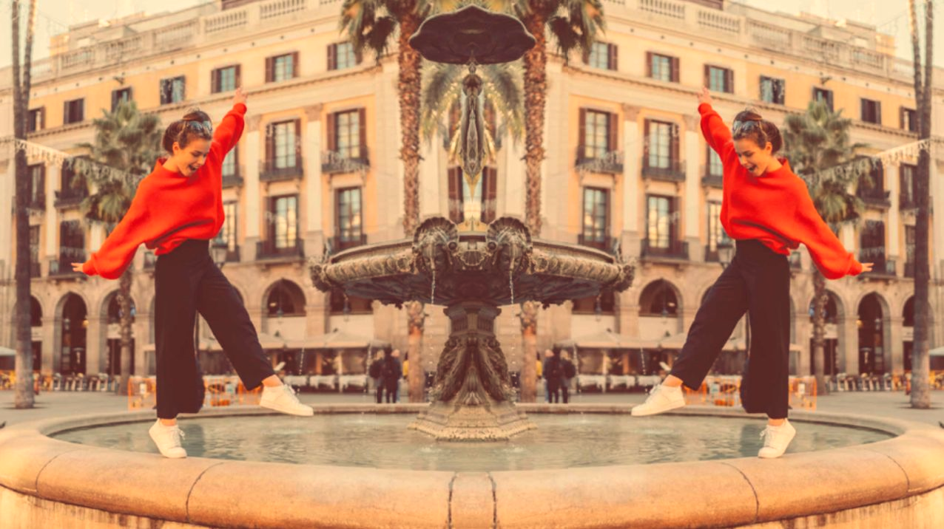
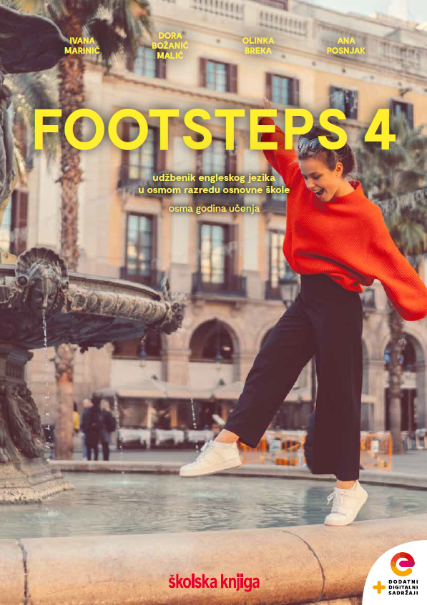

UNIT 4;
All over the map
Lesson 7;
World religions

Slide 2
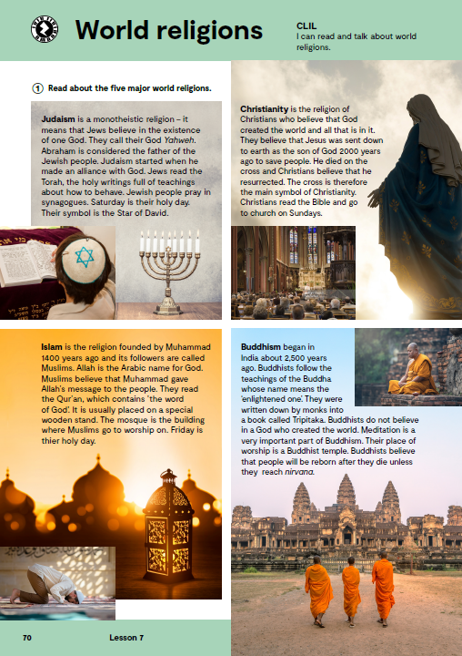
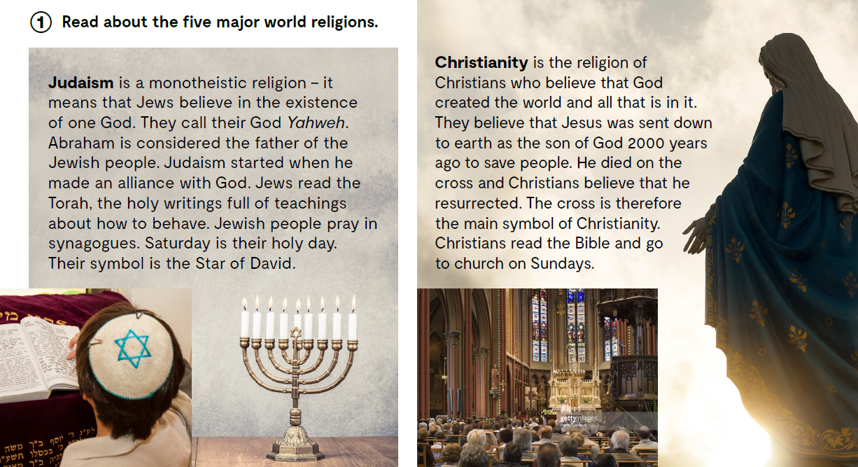
Match the symbol with its name and the religion it represents.
https://wordwall.net/resource/26415188/08u4l7worldreligions
What are the biggest 5 religions in the world?
Which religions are monotheistic, i.e. believe in one god?
Followers of which religion believe in around three millions of gods?
Followers of which religions practice meditation and believe in reincarnation??
Followers of which religion believe that someone was sent down to earth? Pripadnici
Which religion was founded 1400 years ago?
Which religion started when its founder made an alliance with God?
Followers of which religion do not believe in a God who created the world? Pripadnici koje
Read about the five major world religions.

Slide 3
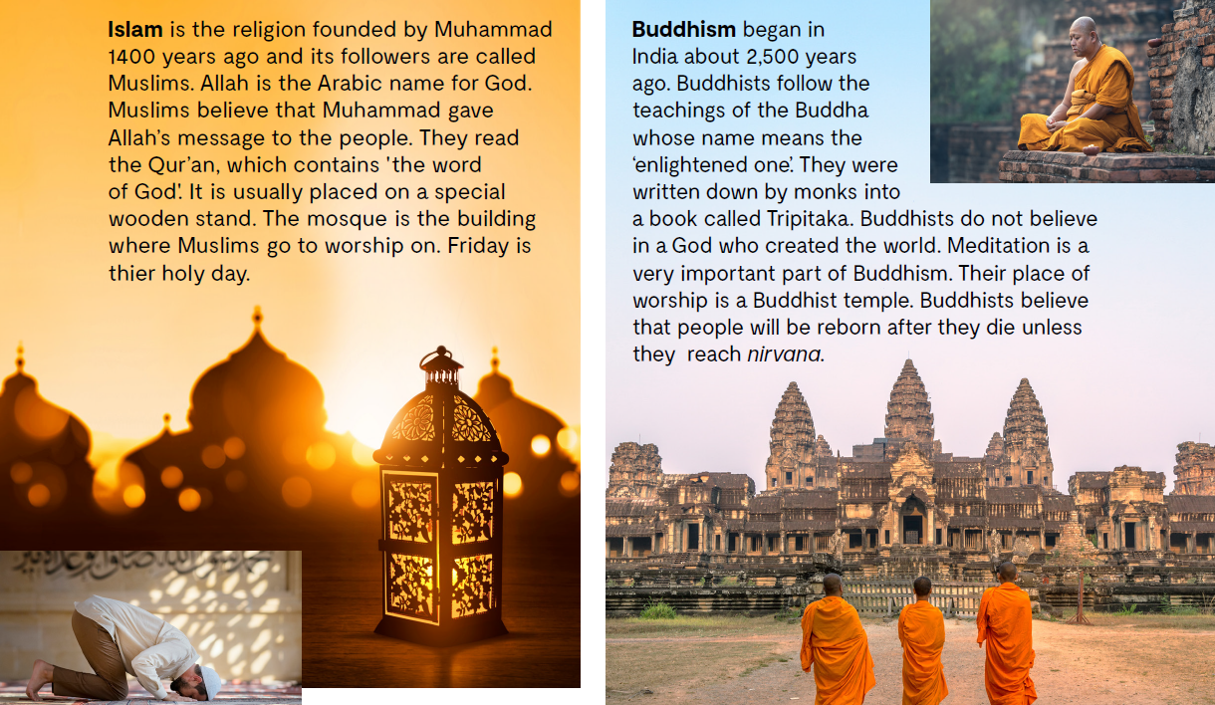

Slide 4
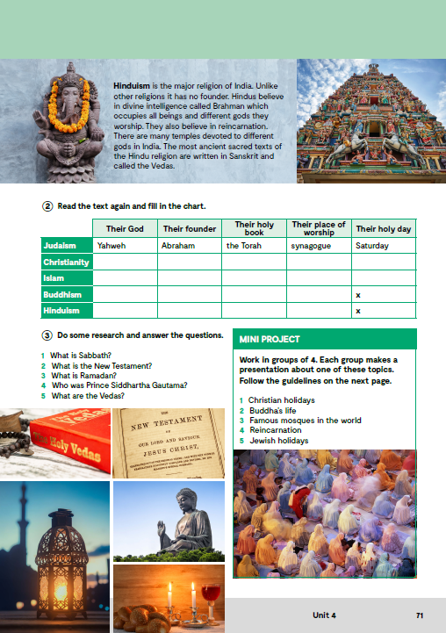
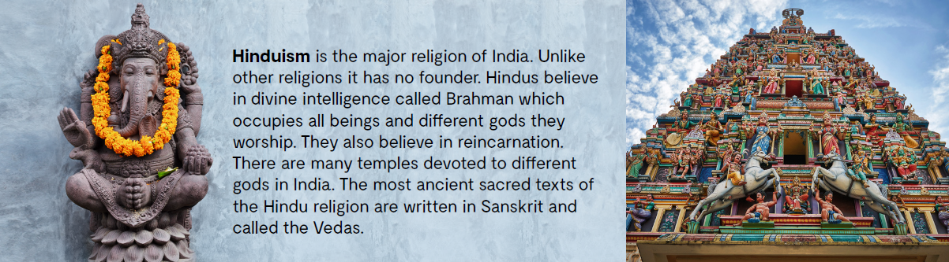

Slide 5
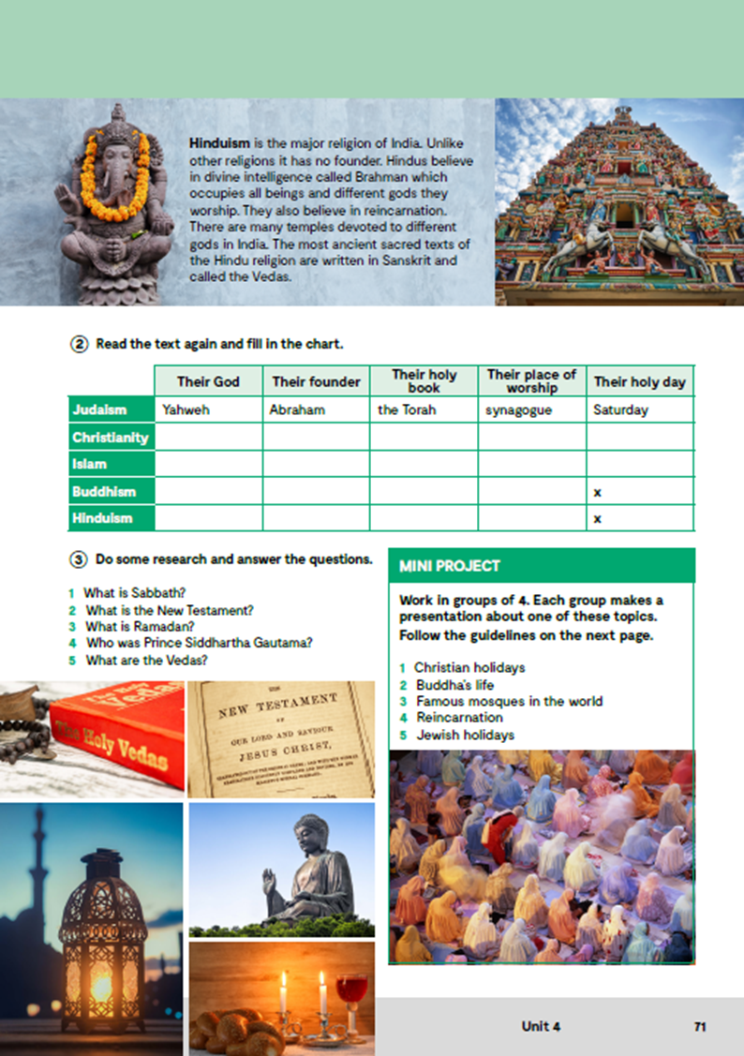
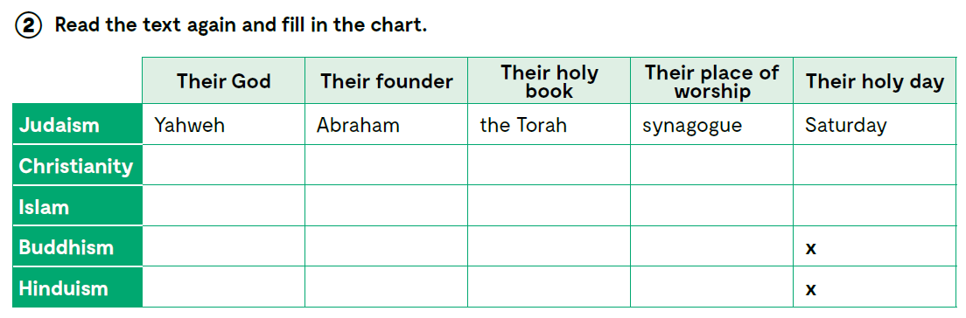
God
Jesus
The Holy Bible
church
Sunday
Allah
Muhammad
The Qur’an
mosque
Friday
none
Buddha
Tripitaka
a Buddhist temple
divine intelligence
Brahman
no founder
the Vedas
temples
Check what you have learnt. Provjeri što si naučio:
https://wordwall.net/play/13057/722/118

Slide 6
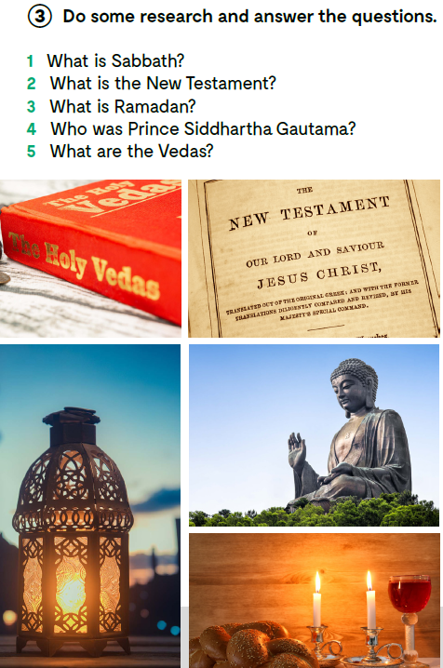

Slide 7
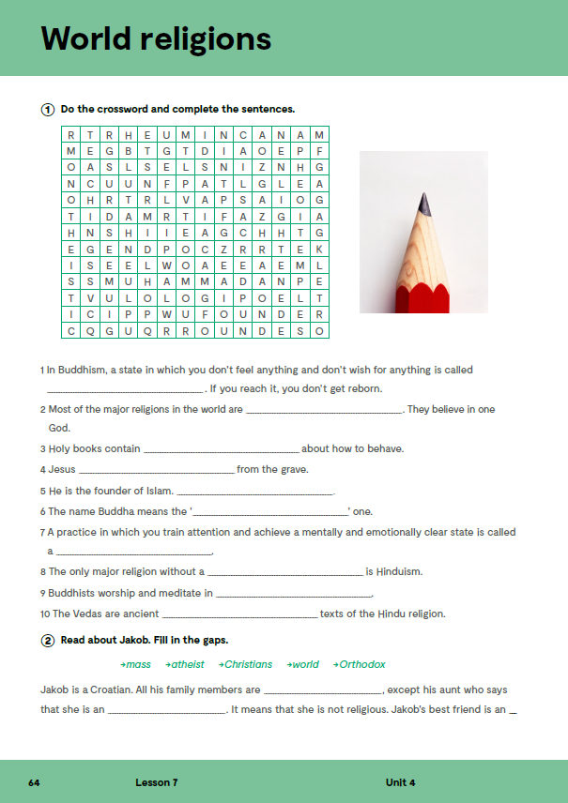
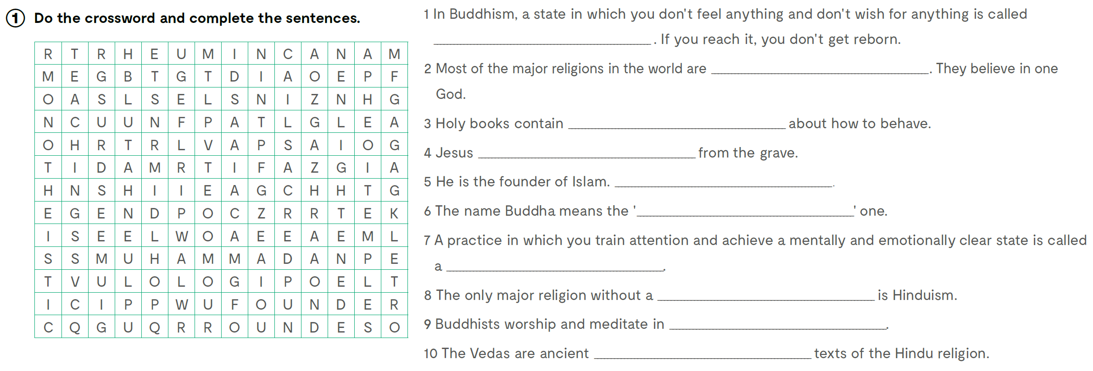
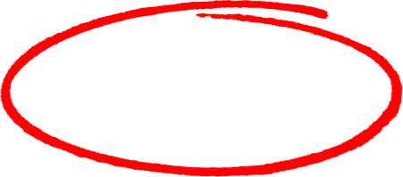


Workbook, page 64.
Do the crossword and complete the sentences.
nirvana
monotheistic
teachings
resurrected
Muhammad
enlightened
meditation
founder
temples
sacred

Slide 8
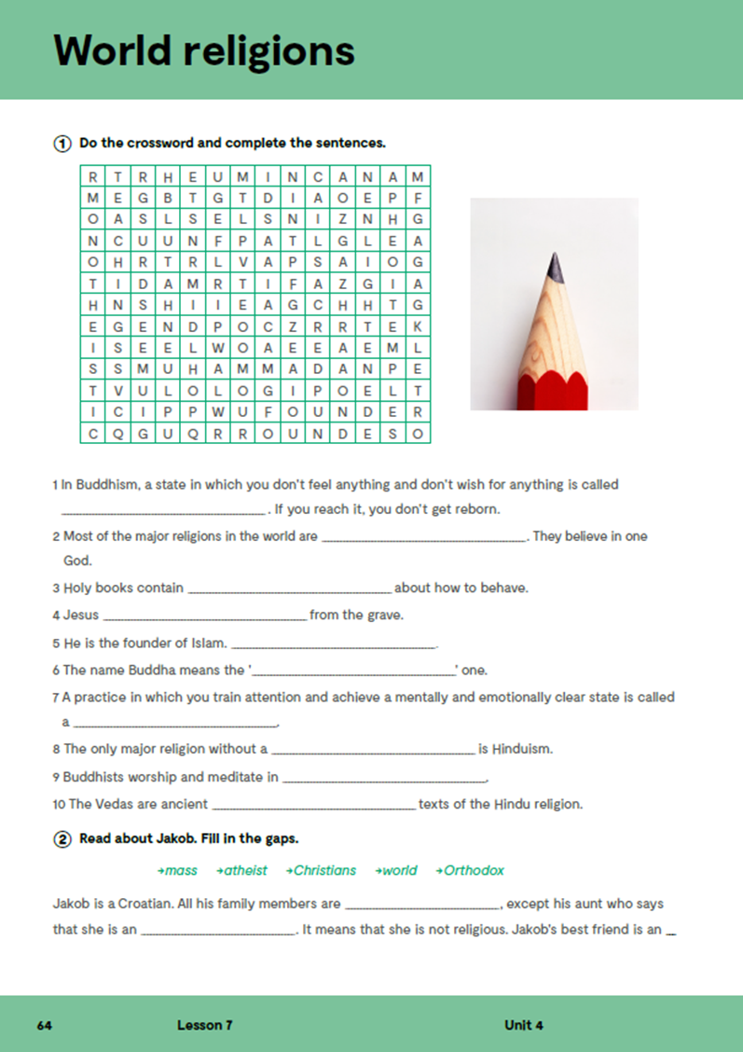
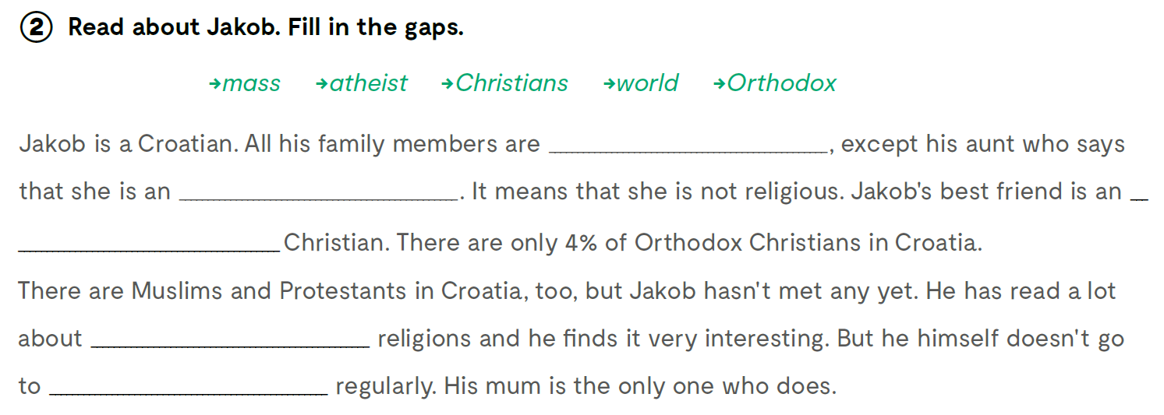
Christians
atheist
Orthodox
world
mass

Slide 9
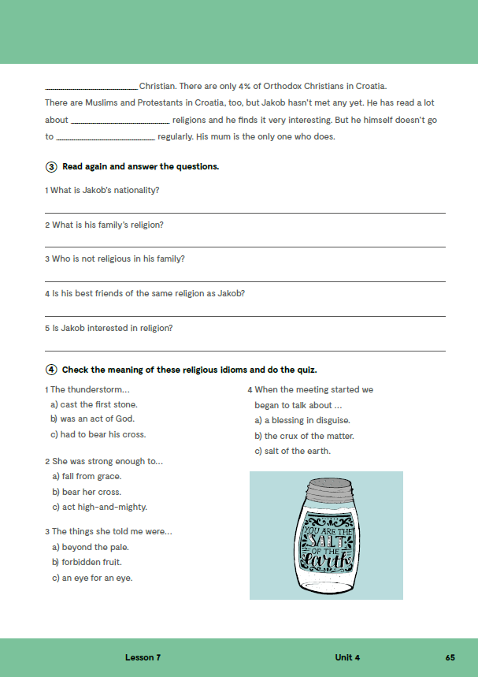
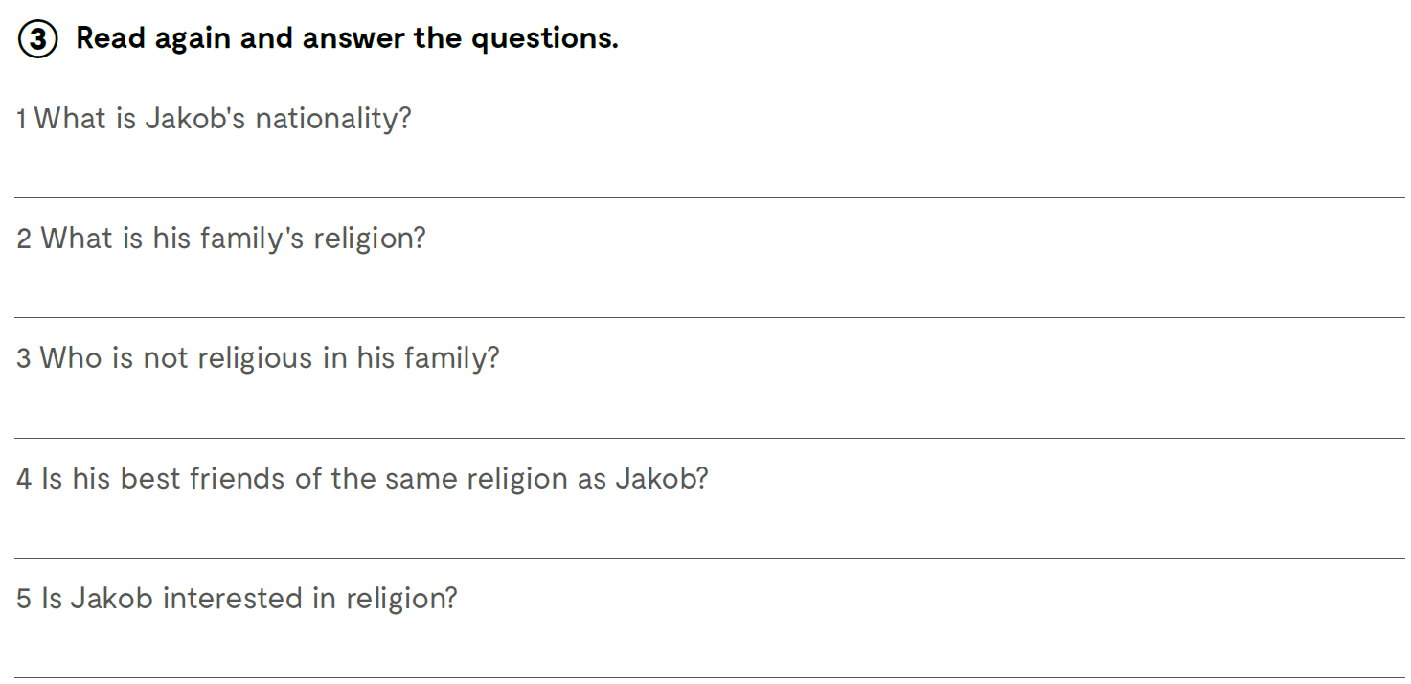
Jakob is a Croatian.
All his family members are Christians.
His aunt is an atheist.
No, his best friend is Orthodox Christian.
Yes, he finds it very interesting, but he doesn't go to mass regularly.

Slide 10

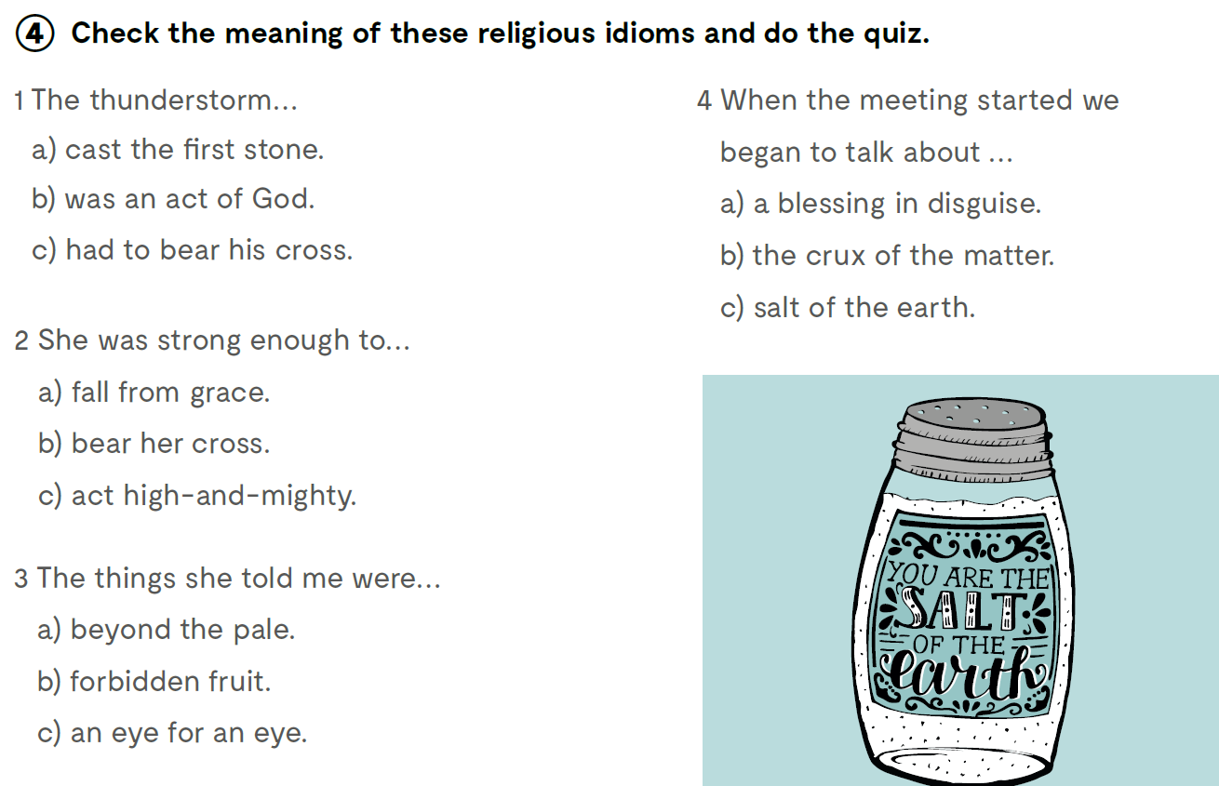


Slide 11
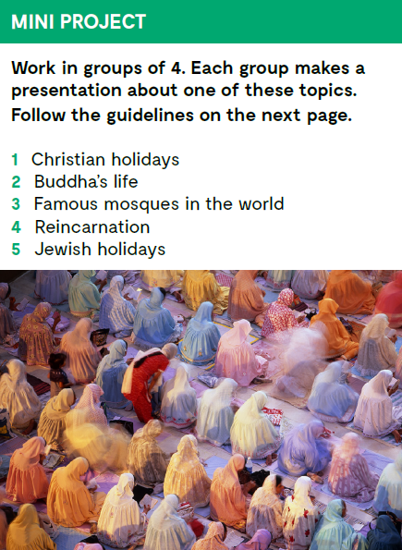

Slide 12
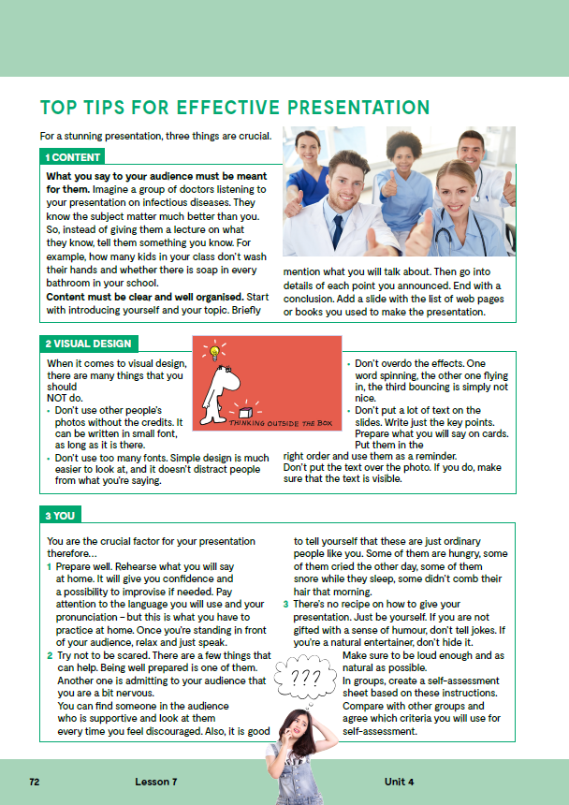
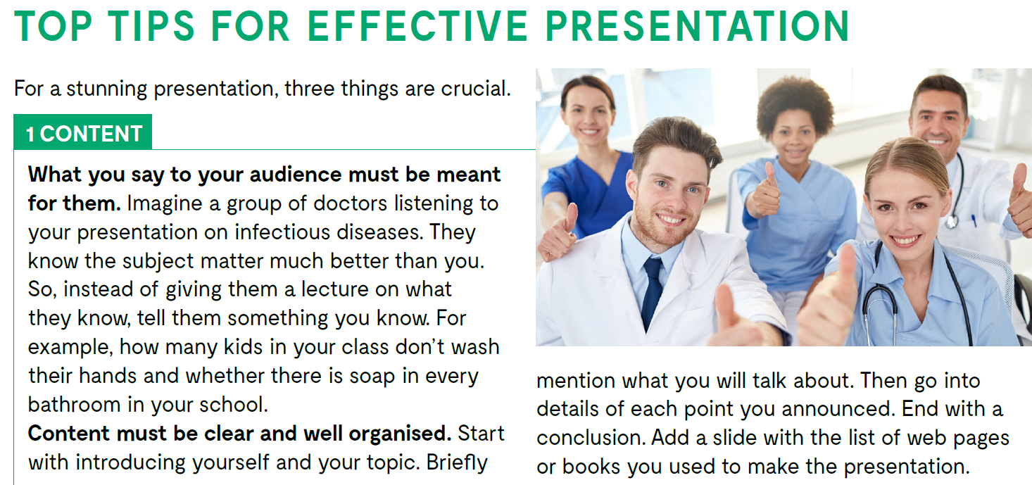
Follow these guidelines while working on your project.

Slide 13
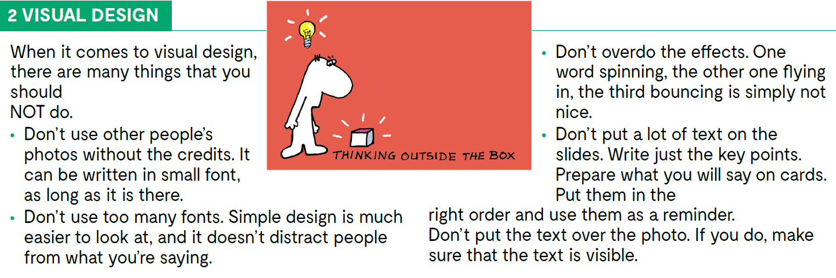
Follow these guidelines while working on your project.

Slide 14
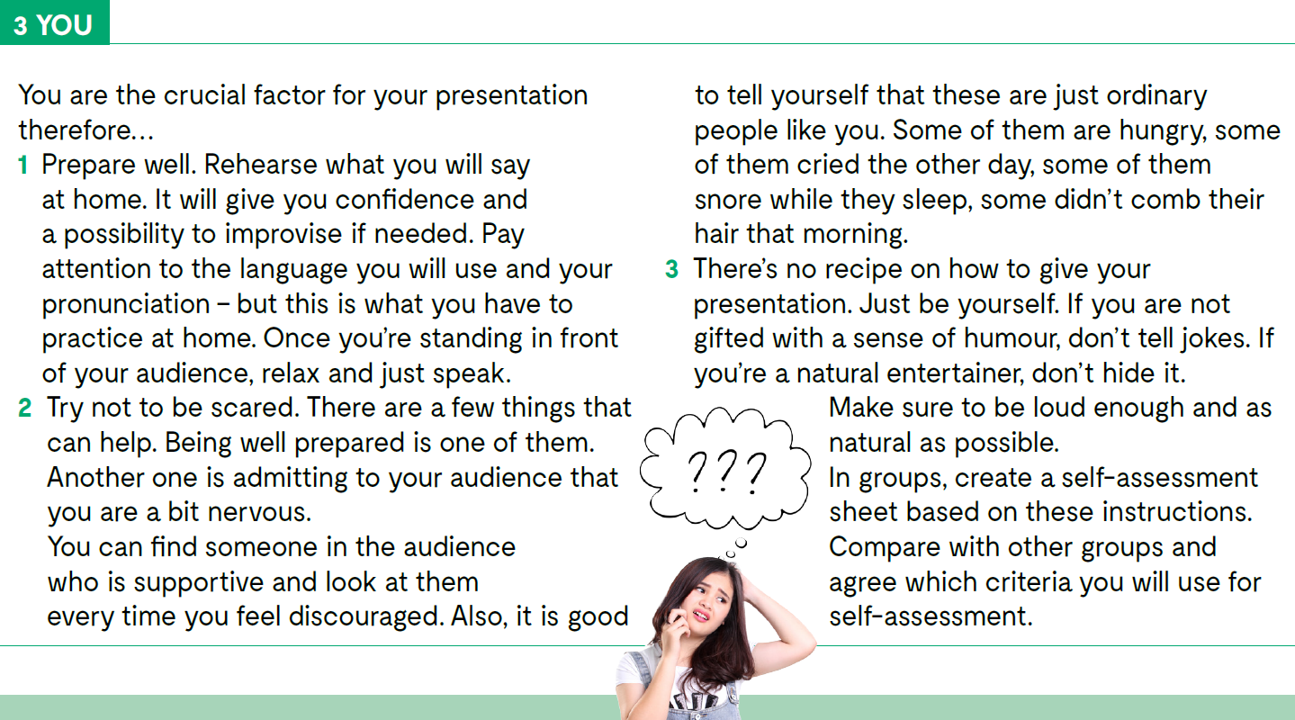
Follow these guidelines while working on your project.

Slide 15

Open the following link and then click on LEARN MORE!
https://www.e-sfera.hr/dodatni-digitalni-sadrzaji/38d736f7-2fab-46b6-baab-8325e821c7bc/
Do people really believe that?
Read the texts and do the tasks.

